Slide 1
What would it take to…
improve the percentage of pregnant women that receive oral healthcare services?

Slide 2
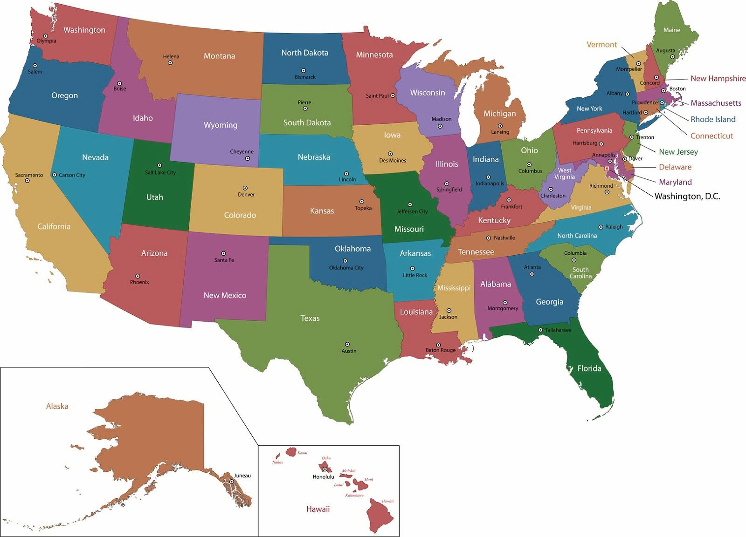
Perinatal Infant Oral Health Quality Improvement (PIOHQI) State Partners (Grant Period: 2013 – 2017)
2013
CT
NY
WV
2015
CA
CO
ME
MD
NM
RI
VA
WI
2016
AZ
MA
MN
SC
TX
Oral Health Resource Center at Georgetown University
Association of State and Territorial Dental Directors
The FrameShift Group
Notes:
HRSA’s MCHB program has been funding work in this space since 2013
16 state grantees
Required QI approach
data-driven decision making… do the steps they take connect to measurable improvement?
Use QI tools and methods to implement
Learning collaborative
FrameShift was brought on in 2015 to be the QI SMEs and facilitate the LC
Used to be at CDHP
Now at Oral Health Resource Center at Georgetown University
Association of State and Territorial Dental Directors (ASTDD)

Slide 3
By 2019, increase by 15% over the state baseline the percent of women who have received oral health care, defined as prophylaxis, during pregnancy, as measured by the PRAMS survey data.
Access & Utilization
Outreach
Policy
Notes:
Global AIM statement
3 priority strategy areas
All states shared common aim and work in common strategy areas
Worked in three primary areas:
Working with clinics and social service programs to measure whether their activities result in care provided
Outreach to the people who work with the people
Policies to create sustainable improvement

Slide 4
Lesson #1
Nothing is as simple as it seems… especially in a clinic.
And especially if you are actually measuring progress.

Slide 5
Social Service/ MCH educates pregnant patients
Does the OB know to refer?
Who to refer? When in gestation? Acute/ preventive?
Pregnant patient receives oral health care
Did patient try to make appointment?
How is referral made? Electronic? Rx?
Who makes referral?
Where to refer? Private/ Public pay?
Do we follow the referral?
How many re-referrals?
Is the whole team doing the same thing?
How often to measure referral rates? Completion rates?
Is risk assessment warranted?
Is practice taking new patients? Specific insurance?
Does the patient have transportation? Childcare?
Does person answering the phone know pregnant patients can receive care?
Did the patient attend the appointment? Re-schedule?
Does the patient have coverage to complete a Tx plan?
Are referrals effective- are the patients going when we refer?
Does dentist know it’s safe to treat throughout pregnancy?
Does the practice share information back to OB?
Are there other reasons a patient wouldn’t return? Mental health?
How does the practice handle no-show rates?
Is the patient told where else to go for help?
Who does the program serve? All pregnant women?
How are professionals trained?
What’s the turnover?
Does education level impact guidance provided?
What should they tell parents? How?
How will professionals answer questions about clinical matters? Insurance?
OB refers pregnant patient
Can we tell if education is actually provided/ referrals made?
How much information is too much for parents?
How frequently should they re-refer?
Are there oral health care centers to refer to?
What could take priority?
Notes:
But WWIT to get social service to provide the education?
As time went on, saw a lot of barriers.
Solving in one site didn’t mean it was always easier in the next
BUT Pre-empting DID make it easier
Shared knowledge (learning collaborative)

Slide 6
Notes:
Example clinical swim lane; co-located services

Slide 7
Lesson #1
SO…
Ask for small things.
Baby steps.
1 clinic at a time.
1 patient at a time.
Clinics don’t have time to go slow.
Nothing is as simple as it seems… especially in a clinic.
And especially if you are actually measuring progress.

Slide 8
Lesson #2
Make sure oral health system is ready.

Slide 9
Education of Clinicians
Medical
Know it’s important!
Dental
Alignment with clinical recommendations
Front Desk and other staff
Global VS Local
Who should educate them, and how?
Can we work with a single dental clinic?
How many dental providers do you need?
Where do you need them?
Notes:
Big mistake – assuming healthcare doesn’t know this is important.
They know it’s important.
They don’t know how to do it
They don’t have time to do it.
They need help integrating it, they need to do it quickly so they can move onto the next thing
About 75% of dental clinics report they see PW, but about 75% of those put unnecessary conditions (no x-rays, only preventive, etc.)
Does this result in butts in chairs?

Slide 10
Ready for Referrals
Barriers & Solutions
Co-location
Don’t assume they know each other
Don’t rely on EMR/EDR
Warm hand-offs
Same-day appointment slots
Scheduling dental/prenatal same day
The fear of the “no-show”
Refer to same place every time
Rx from OBs
Care coordination and tracking referrals
Notes:
Most sites – first time medical and dental ever worked together
MN – was a service provider and went to sites
No-show real issue; Tracking data shows just as bad as private pay
WI – all referrals to one community provider in rural communities
Caution Rx…. Not necessary, only a band-aid; not needed in the future

Slide 11
Lesson #2
SO…
Go beyond education.
How will you actually get ready to see patients, follow them and support them in completing treatment plans?
Make sure oral health system is ready.

Slide 12
Lesson #3
Policy comes in all shapes and sizes.

Slide 13
Policy Strategies
BECAUSE OF THE TIME WE HAVE WITH COVERAGE, ASK ONE QUESTION: Did you know you have dental coverage while you’re pregnant?
Standard curriculums for dental hygiene programs
Standardize dental referrals in policy and procedure
Integrating training into new-hire onboarding
Standardize data collection
Regional training systems with sustained funding
Integrate oral health into other initiatives
MCO outreach procedure change – live, human interaction
MCO incentives for OB referrals and/or patients
Notes:
If you identified someone at 8 months and they only had a benefit while they were pregnant, it didn’t do much good since the benefit expired.

Slide 14
Remember…
Things will be complicated, so start small.
Dental system needs to be ready, so know how to get them to start thinking procedural.
Policy options are diverse, so start the work now because it takes time.

Slide 15
One more thing…
Long-term data collection & utilization plans
Site-level
State-level
Social service programs
Willing to educate
Testing referrals more challenging
Performance standards
Champions are critical
Focus on reliable systems to achieve aims over time
Watch out for other priorities
CHW licensure
Notes:
WIC BSS in VA – review every 5 years

Slide 16
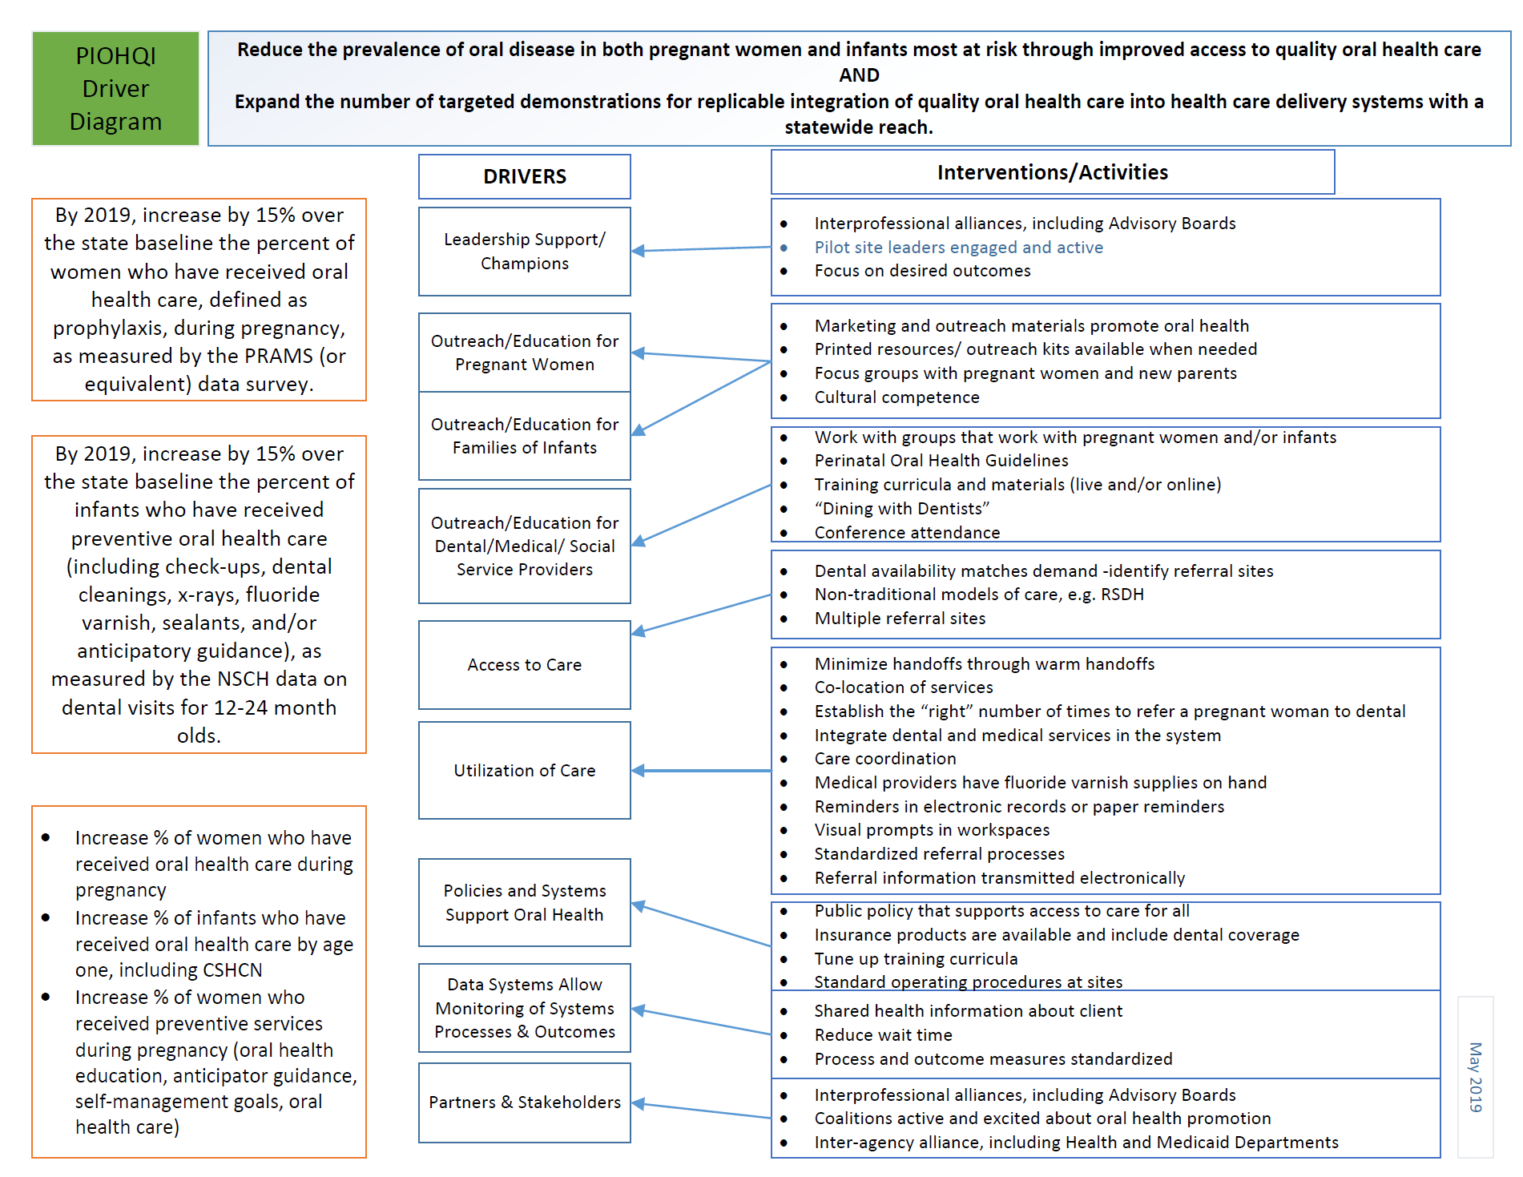

Slide 17
Rebecca Nevedale Rebecca@frameshiftgroup.com 602-540-8371
Denise Helm, RDH, EdD AZ PIOHQI Initiative: Project Zero—Women & Infants Denise.Helm@nau.edu

