Slide 1
Welcome to AzPHA’s 2021 Fall Conference! August 26, 2021
Title Sponsor

Slide 2
Welcoming Remarks Pele Peacock Fisher, AzPHA Board President
Title Sponsor

Slide 3
AzPHA recognizes & Thanks Our Sponsors & Exhibitors Looking to the Future: Arizona’s Public Health & Healthcare Workforce Thursday, August 26, 2021 Desert Willow Conference Center, Phoenix

Slide 4
Title Sponsor

Slide 5
Gold Sponsors

Slide 6
Silver Sponsors

Slide 7
Bronze Sponsors

Slide 8
Exhibitors
American College of Education
Arizona Council of Human Service Providers
ASU Edson College of Nursing & Health Innovation
AZ Family Health Partnership
Aunt Rita’s Foundation
Central AZ Area Health Education Center

Slide 9
Exhibitors
Compassion & Choices
Curative, Inc.
Fort Defiance Indian Hospital Board
Grand Canyon University
Molina Healthcare
Solari Crisis & Human Services

Slide 10
Exhibitors
Stop Dark Money & Arizona Deserves Better
Terros Health
The Arizona Partnership for Immunizations
Mel & Enid Zuckerman College of Public Health
Vitalyst Health Foundation
Western Region Public Health Training Center

Slide 11
Special Acknowledgements
Program Design: Sheryl Clements
A/V Assistance: Steven Becker, ADHS

Slide 12
Thank You to Our Board!
Pele Peacock Fisher, JD President
Aimee Sitzler, Immediate Past President
Kim Val Pelt, President Elect
Kelli Donley Williams, Vice President
Felicia Trembath, Secretary
Sean Clendaniel, Treasurer
Rebecca Nevedale, Affiliate Representative on the Governing APHA Council
Susan Gerard, Director at Large
Zaida Dedolph, Director of Public Policy
Eric Tomlon, Director of Professional Development
Zeruiah Buchanan, Public Member
Michael Murphy, Director of Marketing & Public Relations
Carly Camplain, Student Representative
Lilliana Cardenas, Director at Large
Mac McCullough, Public Member
Leslie Horton, Director at Large

Slide 13
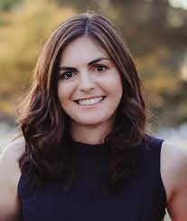
Looking Toward the Future:
The State and Regional AHEC Priorities in a Post-Pandemic Arizona
Moderator:
Leila Barraza, JD, MPH,
UArizona Area Health Education Center (AHEC) Director
Panelists:
Ana Roscetti, Director, Central Arizona AHEC
Marica Martinic, MPH, Director, Northern Arizona AHEC
Brenda Sanchez, Border Binational Program Coordinator, Southeast Arizona AHEC
Joena Ezroj, Western Arizona AHEC
Kim Russell, Representative on Behalf of the new Tribal AHEC
Play Video: https://youtu.be/DHq7f_500Gk

Slide 14
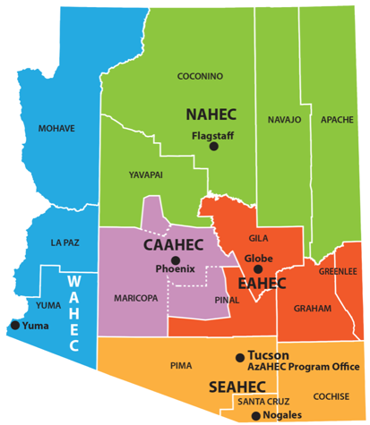
Since 1984 the AzAHEC mission:
to enhance access to quality primary care by improving the supply and distribution of health care professionals through academic community partnerships in rural and medically underserved areas.
Five AzAHEC Regional Centers
Central Arizona AHEC (CAAHEC) Phoenix
Eastern Arizona AHEC (EAHEC) Globe
Northern Arizona AHEC (NAHEC) Flagstaff
Southeast Arizona AHEC (SEAHEC) Nogales
Western AHEC (WAHEC) Somerton
AzAHEC Program Office
University of Arizona Tucson

Slide 15
Pipeline to Practice
K-12 Pre-Professional
BLAISER, HOSA, Med-Start, SCRUBS
Undergraduate
Community Colleges, Universities
Teaching, Precepting, Practicing
Licensed, Practicing
Graduate
DDS, DO, MD, MPH, NP, PA, RN CNM,
PharmD, DNP, PT
Intern, Resident, Fellow
Graduate Medical Education

Slide 16
Looking Toward the Future:
The State and Regional AHEC Priorities in a Post-Pandemic Arizona
Ana Roscetti, Director, Central Arizona AHEC

Slide 17
Central Arizona Area Health Education Center (CAAHEC) Ana Roscetti, MPH AZ Public Health Summit August 26, 2021

Slide 19
Student Reflections
After this trip, I have learned a lot about myself and my current practice and how I will take more time to understand patients and their traditions. I hope many more students can go and experience and learn about the Native culture and see firsthand the disparity there is in Gallup. It is eye opening.
I had no idea the impact this trip would have on my career as an advanced practice nurse and as a human being.
It is experiences like this that can transform lives and perspectives and inspire others to give back. I will remember this experience as a highlight of my doctoral studies and always be grateful for the opportunity.

Slide 20
Workforce Development (AACHC/CAAHEC)
Arizona Alliance for Community Health Centers
Designated by HRSA as the State Primary Care Association
Membership of 23 FQHCs in over 170 sites across Arizona
Mission: To promote and facilitate the development and delivery of affordable and accessible community-oriented, high quality, culturally effective primary healthcare for everyone in the state of Arizona through advocacy, education and technical assistance.
Workforce Development Goals:
Foster a Workforce to Address Current and Emerging Needs
Advance Health Center Clinical Quality and Performance
Objectives:
Workforce Planning and Implementation
Workforce Advancement
Quality of Care Outcomes
Workforce Development Planning and Readiness to Engage in Health Professions Training

Slide 21
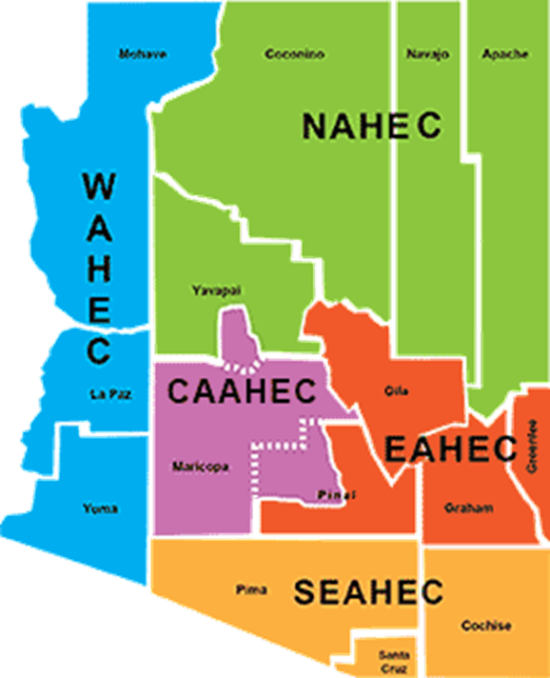
Overview – Workforce Development (AACHC/CAAHEC)
Central Arizona AHEC
Sponsored by the AACHC and was established as the 5th AHEC in July 2019
Serves Maricopa County, West Pinal and South Yavapai Counties
Mission: To improve the supply, distribution, and diversity of our health care workforce through academic and community partnerships.

Slide 22
CAAHEC’s Priorities
Workforce Planning and Implementation
Community-Based Experiential Training (CBETs)
Leverage new and existing partnerships to expand CBETs
Identifying funding for new programming
Pipeline Programs
Work with academic partners to bolster pipeline programs and create impact in heath career program admission and recruitment
Interprofessional/Continuing Education
Identifying opportunities to cross-collaborate for inter-professional education
Support providers and communities with health education efforts
Workforce Advancement
Teaching Health Center Graduate Medical Education

Slide 23
Thank You!
Ana Roscetti, MPH
Anar@aachc.org

Slide 24
Looking Toward the Future:
The State and Regional AHEC Priorities in a Post-Pandemic Arizona
Marica Martinic, MPH, Director, Northern Arizona AHEC
Our new name is ‘Colorado Plateau Center for Health Professions’
Play Video: https://youtu.be/DHq7f_500Gk

Slide 25
Looking Toward the Future:
The State and Regional AHEC Priorities in a Post-Pandemic Arizona
Brenda Sanchez, Border Binational Program Coordinator, Southeast Arizona AHEC

Slide 26
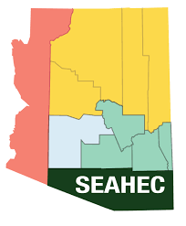
Southeast Arizona Area Health Education Center
Past, Present & Future Building Health Workforce & Healthier Communities

Slide 27
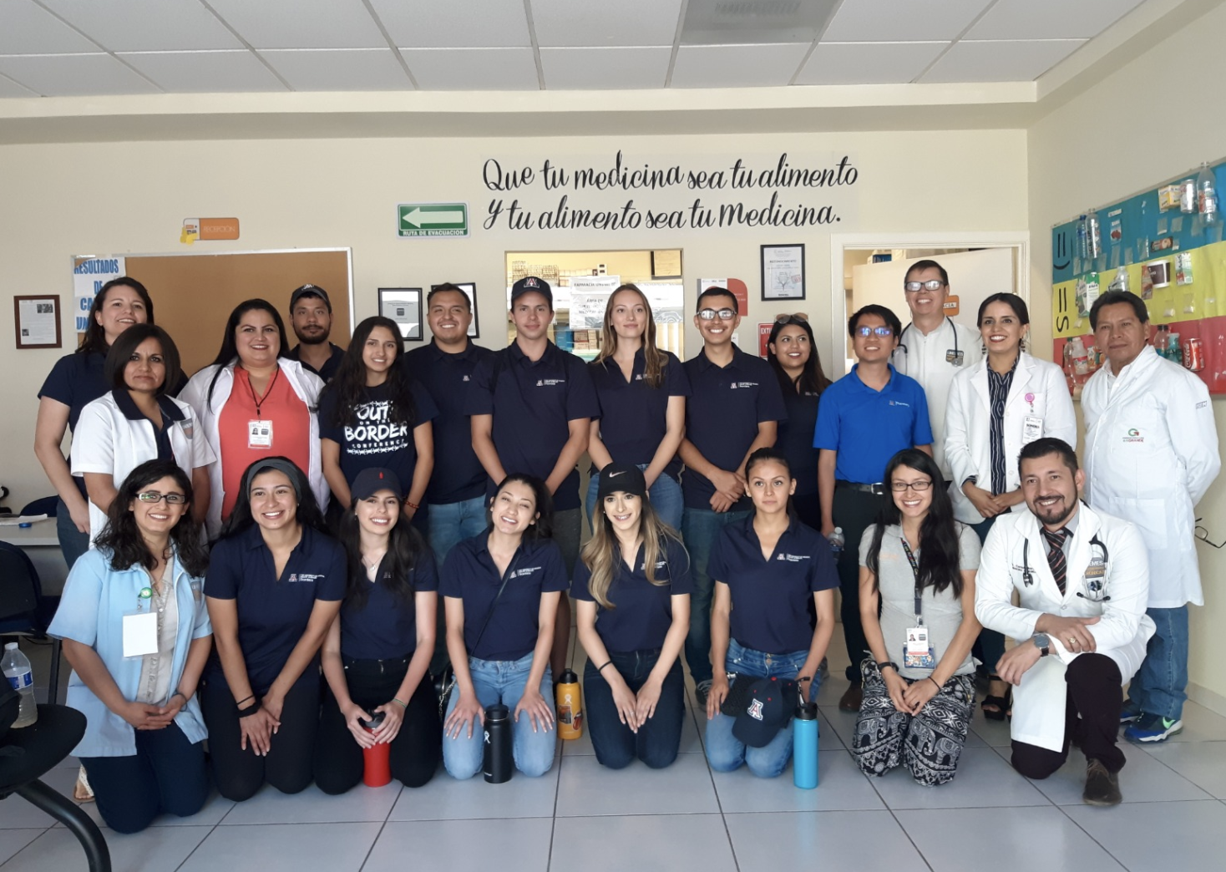
Past: Summary of accomplishments to date
First AHEC center to be established in Arizona, in 1985
Health Career Clubs supporting 100’s of students to go to college and choose a health career
Student training and placement – 1000’s of health professions students in clinical and community settings
Continuing Education/Medical education – over 15,000 CE credits offered, hosting EMS on border for 30 years!

Slide 28
Present:
Beginning Sept 1, we will no longer be contracting with UA/BOR as official AHEC site
However we will continue as a stand-alone 501©3 focusing on border, rural and vulnerable communities

Slide 29
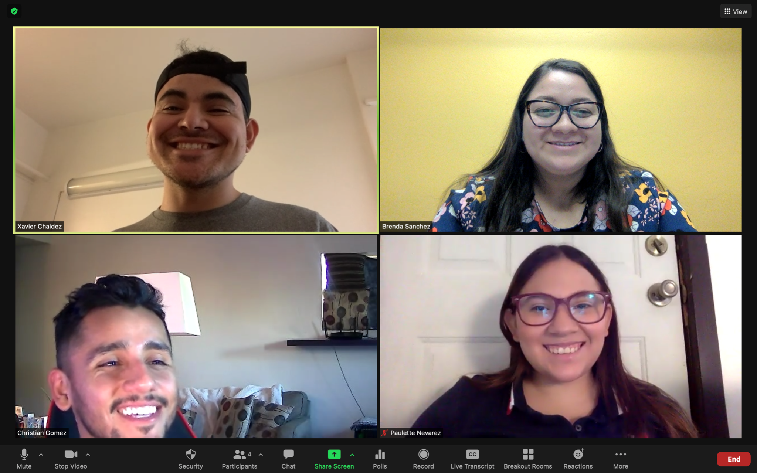
Future: CHW Workforce Development
SEAHEC awarded a $1 million HRSA local community workforce for COVID vaccine & hesitancy education
SEAHEC awarded a CDC Foundation COVID outreach grant – working with Casa Alitas shelter & 4 partner AHECs
SEAHEC partnering with SEAGO to conduct COVID outreach with elders in Graham, Greenlee, Cochise & Sta. Cruz counties

Slide 30
Future: SEAHEC a Hub for Border & Migrant Health Advocacy, Research & Action
Continue work with established partners – Example: Mariposa CHC with SOSA Consortium
Expand partnerships for cross border collaboration on migrant health and advocacy
Grow border and migrant health service learning opportunities

Slide 31
Looking Toward the Future:
The State and Regional AHEC Priorities in a Post-Pandemic Arizona
Joena Ezroj, Western Arizona AHEC

Slide 32
Regional Center for Border Health, Inc. San Luis Walk-In Clinic, Inc.
Western Arizona Area Health Education Center
August 26, 2021

Slide 33
The State and Regional AHEC Priorities in Post Pandemic Arizona
Looking Toward the Future:

Slide 34
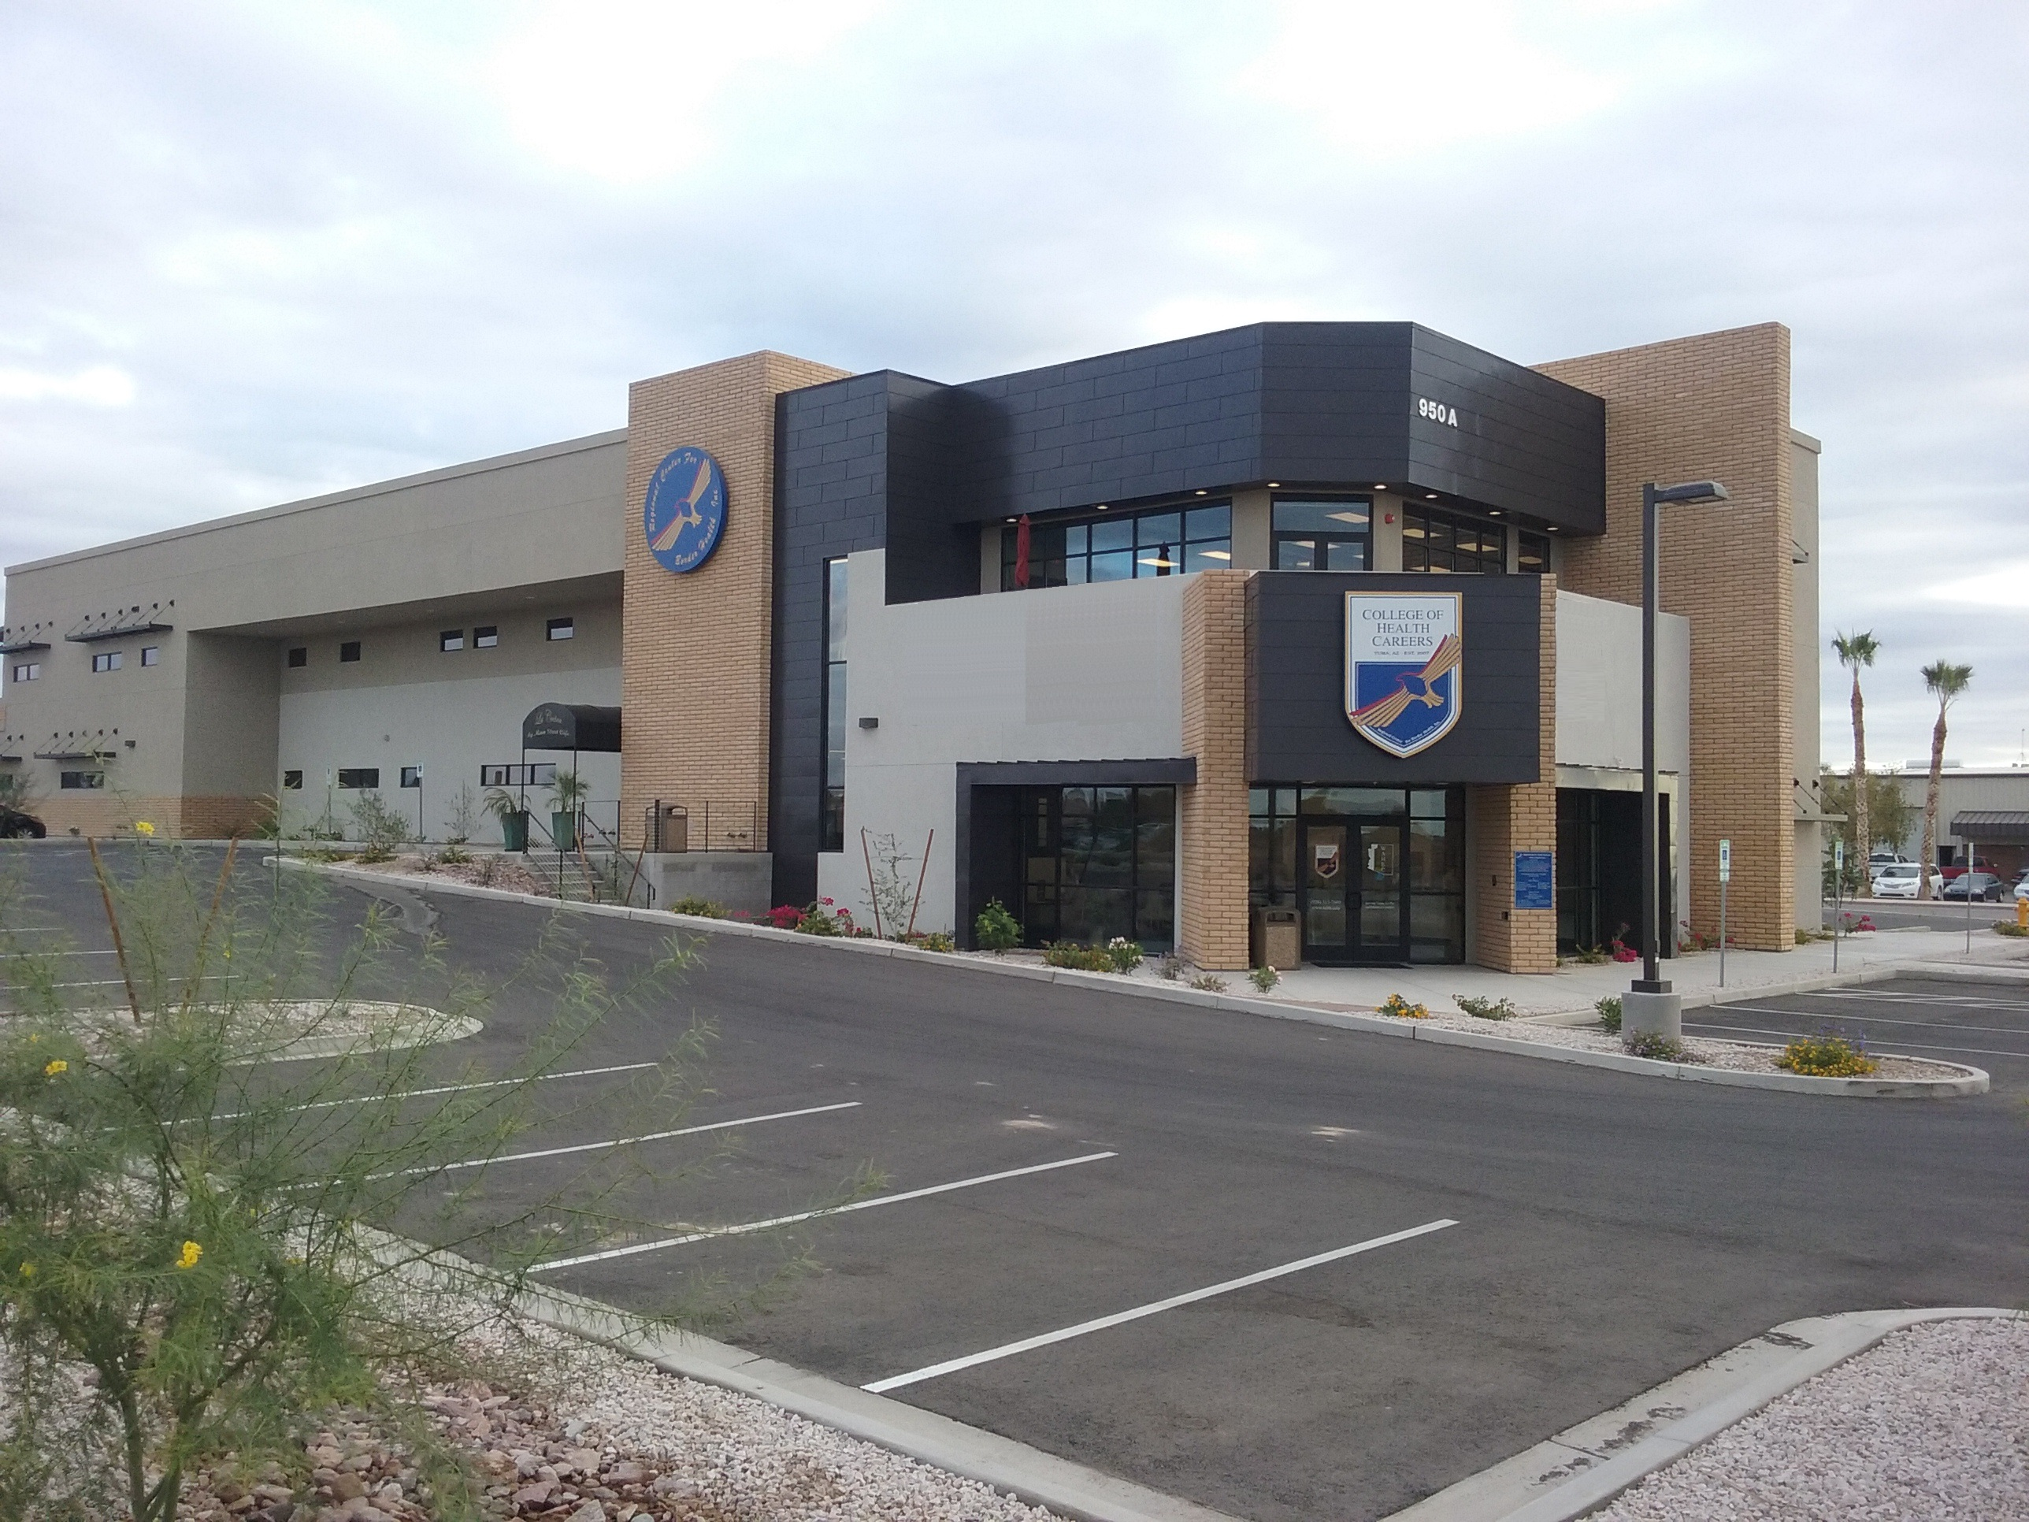
“Committed to improving the quality of life of the residents along the U.S.-Mexico Border by increasing accessibility to quality training and affordable healthcare”
Regional Center For Border Health, Inc/WAHEC Headquarters in Somerton AZ

Slide 35
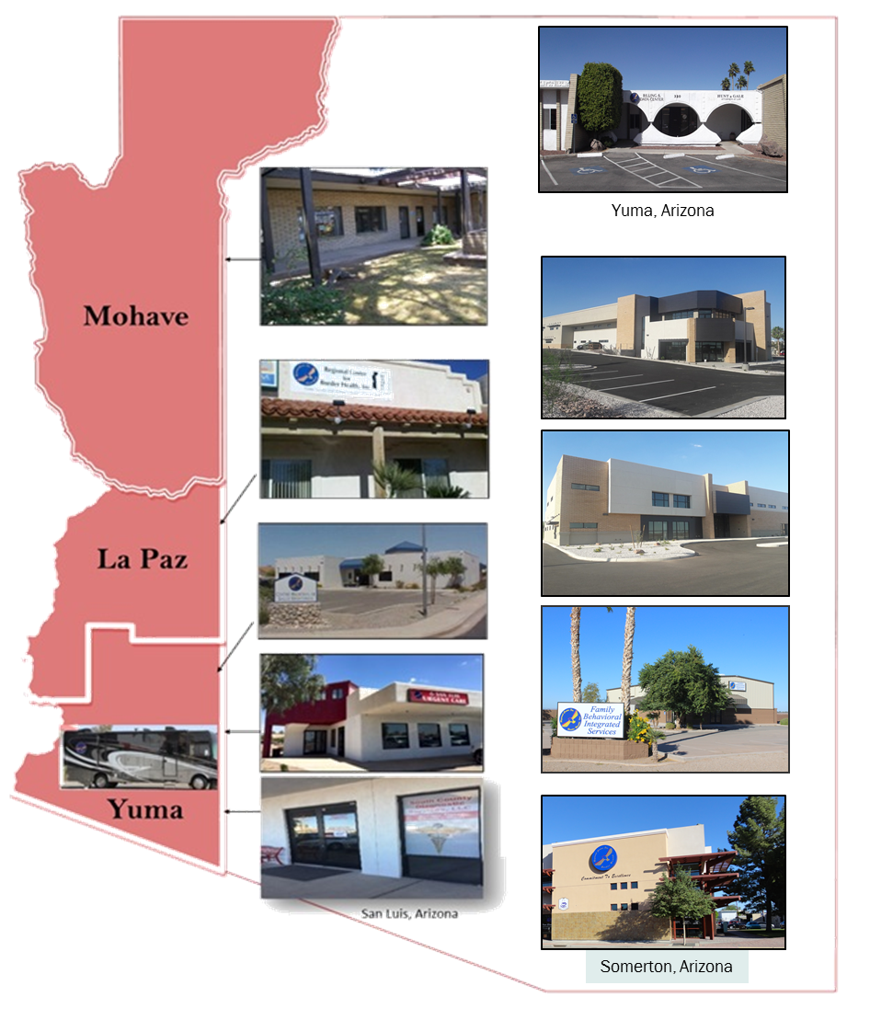
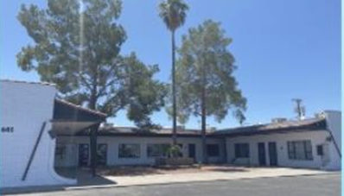
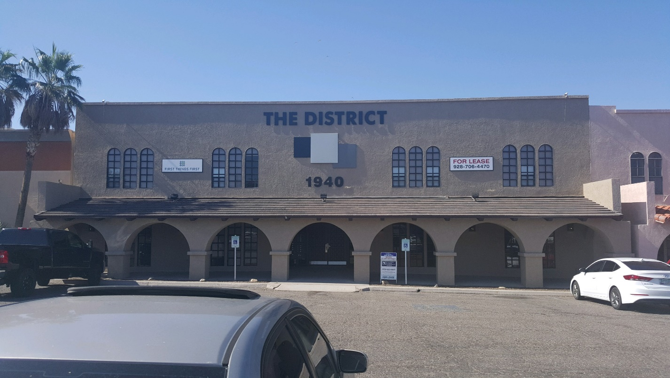
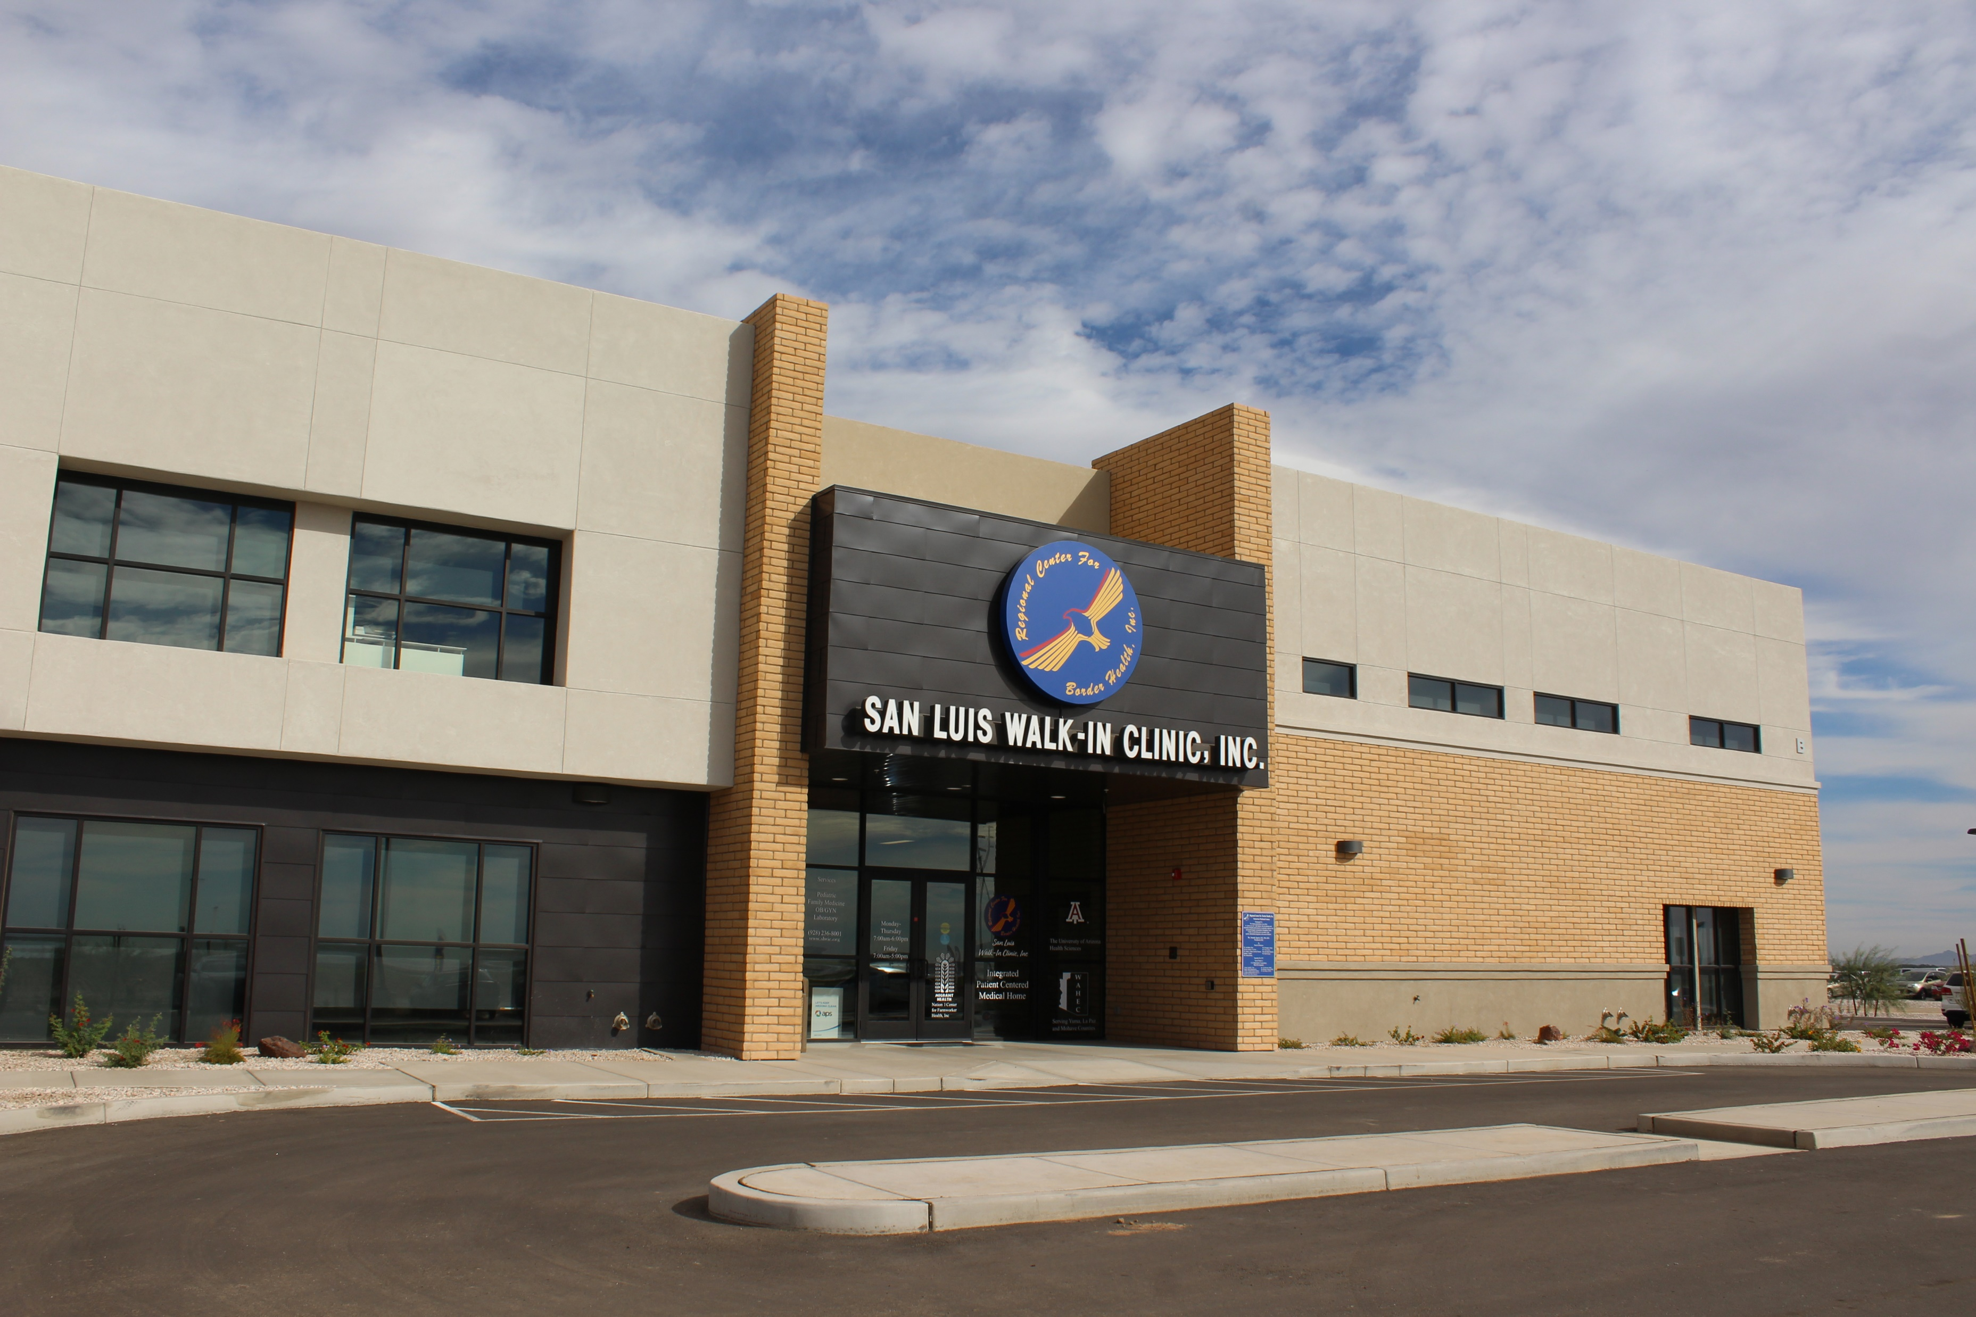
Notes:
Add medical mall

Slide 36
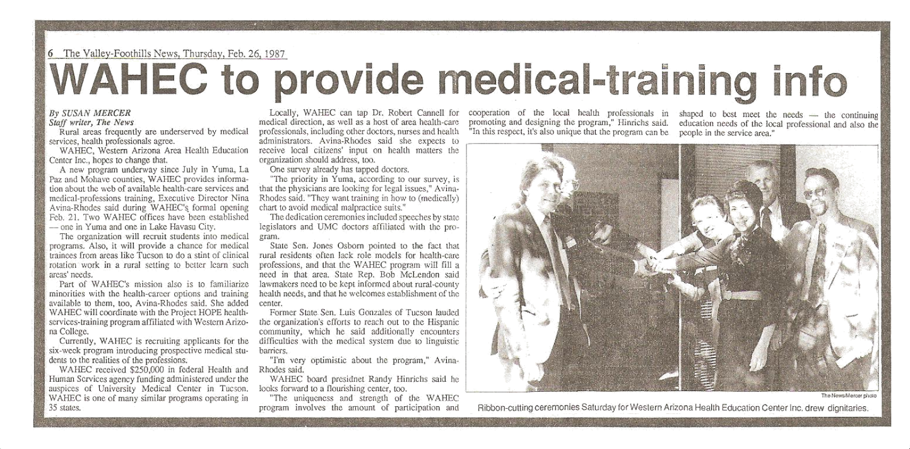
Western Arizona Area Health Education Center Established in 1987
The principal mission of Arizona's Area Health Education Centers (AHEC's) is to improve the health status of Arizona's rural and medically underserved communities through the improvement of retention, distribution, supply, diversity, quality and efficiency of health professionals serving these populations.

Slide 37
Addressing Healthcare Disparities
Access to
Affordable Healthcare
Quality
Assurance & Population
Health Outcome
Health Promotion and
Disease Prevention
Social Determinants of
Health (SDoH)
Health Professional
Recruitment and Retention &
Interprofessional Clinical
Rotations

Slide 38
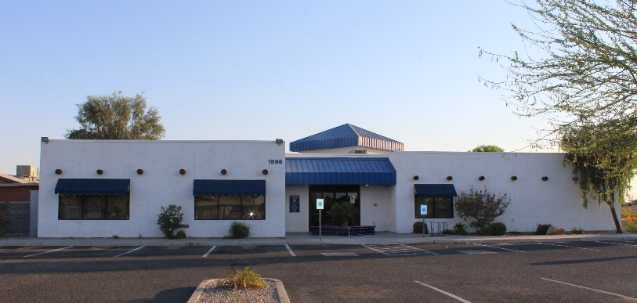
San Luis Walk-In Clinic, Inc. Integrated Behavioral Health
Patient-Centered Medical Home
A Medical Home is defined as primary care that is accessible, continuous, comprehensive, family centered, coordinated, compassionate and culturally effective.
Meaningful Use (All Stages)

Slide 39
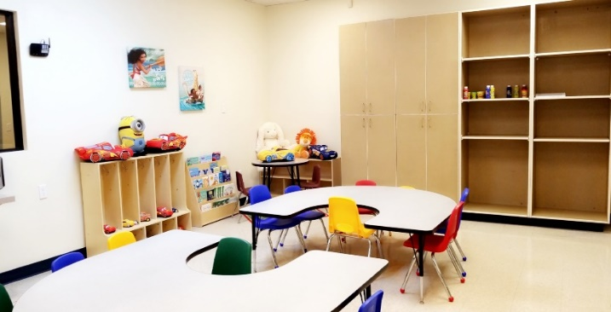
Center for Children with Special
Needs and Autism
A multidisciplinary resource center for families and their children with special needs and autism spectrum disorder.
Multidisciplinary care management team:
• Pediatrician
Psychiatrist
• Psychiatric Nurse Practitioner
• Psychologist
• Licensed Social Worker
• Registered Dietician
• Licensed Speech Pathologist/Feeding Clinic
• Family Care Coordinator

Slide 40
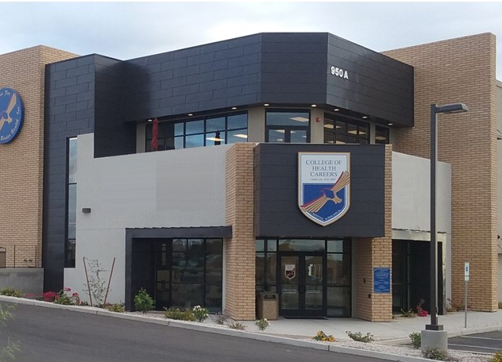
Health Professional Recruitment and Retention & Interprofessional Clinical Rotations

Slide 41
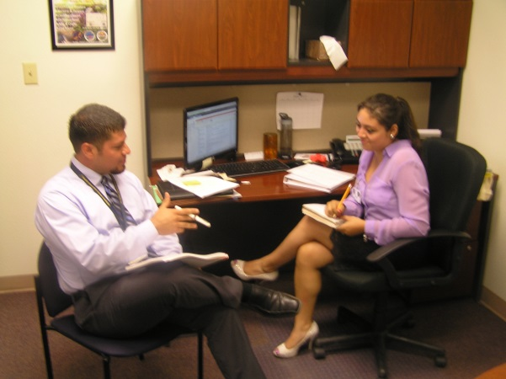
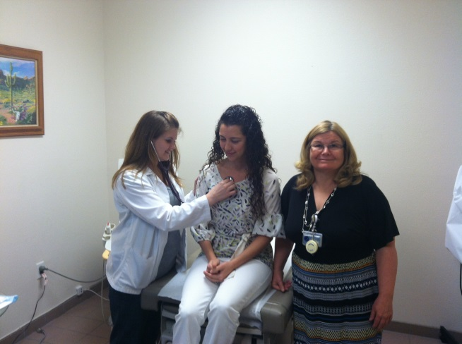
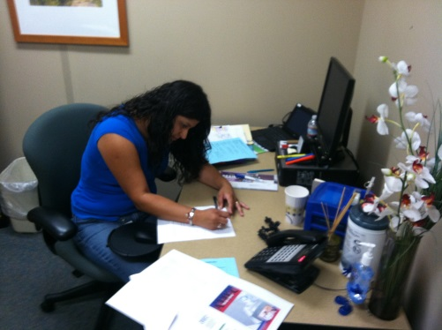
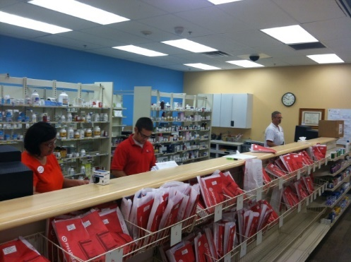
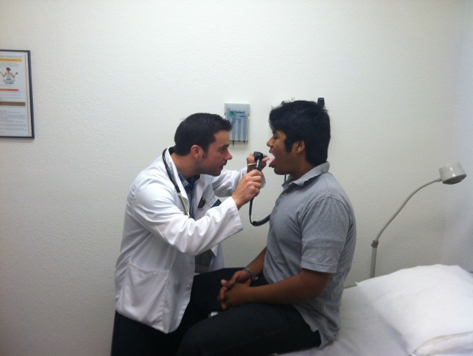
Interprofessional Clinical Rotations
NAU – Social Work
NAU – Speech Pathologist
South University Georgia – P.A
U of A – College of Pharmacy
Chatham University – P.A

Slide 42
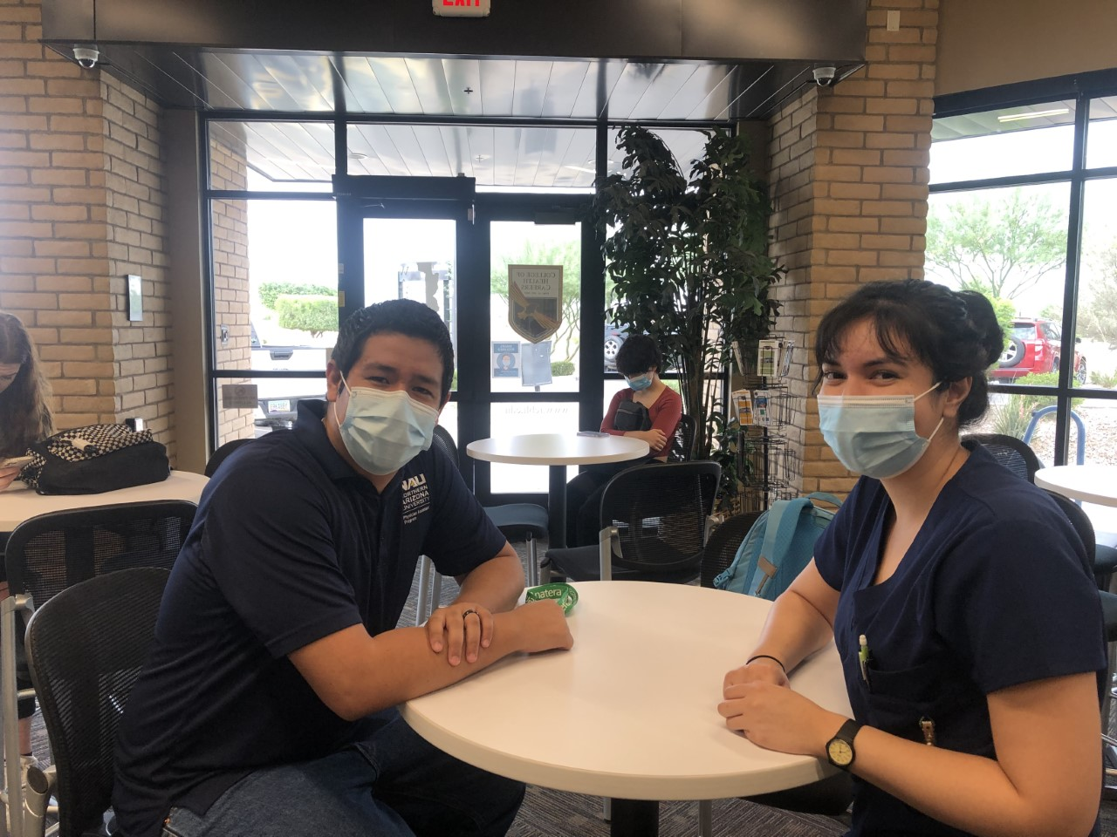
Interprofessional Clinical Rotations
NAU – Social Work
NAU – Speech Pathologist
South University Georgia – P.A
U of A – College of Pharmacy
Chatham University – P.A
Notes:
Student success story—Oscar Campuzano, PA and CHC CNA Grad student discussing PA pathway

Slide 43
Interprofessional Clinical Rotations
The Program Mission Award is awarded to the graduating student who best exemplifies the program’s mission – which is to educate competent clinicians who provide high quality,
ethical, culturally appropriate primary health care to individuals across the life span, within the context of the family and community, and to prepare graduates to practice in diverse settings throughout Arizona, with special emphasis on rural communities and other medically underserved communities. This year’s recipient
Of the program mission award is Oscar Campuzano.
Oscar’s selection for the award was based upon his abundant experience in rural and underserved settings, which included a significant amount of time at RCFBH. Additionally, his desire for seeking employment opportunities in these areas contributed to his selection. He will be a fantastic provider and PA.
--Jacob Gubler, NAU PA Program Coordinator and Professor
Notes:
Student success story—Oscar Campuzano, PA and CHC CNA Grad student discussing PA pathway

Slide 44
Interprofessional Clinical Rotations
(FYE 2019-2020)
#259 Students’ Rotations

Slide 45
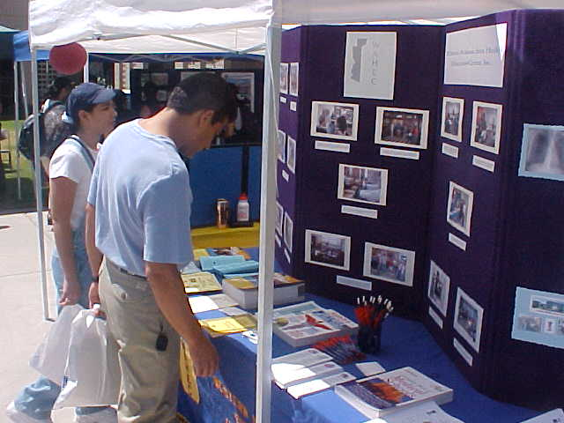
“Growing Our Own” Health Professional Recruitment and Retention & Interprofessional Clinical Rotations
Medical Student Rotation
Border Health Career
Health Career Clubs (HOSA)
RHPP
Pharmacy Camp
Future Health Leaders
Health Career Opportunities Program— Summer Opportunities:
Med-Start Summer Enrichment (U of A)
Minority Medical Education Program Opportunity (U of A)
PREP Summer Enrichment Opportunity (NAU)
LIC Longitudinal Integrated Curriculum (U of A)
Notes:
Martita’s slide

Slide 46
Accrediting Bureau of Health Education Schools (ABHES)
The RCBH-College of Health Careers was accredited by ABHES
Effective August 1, 2013,
The Accrediting Bureau of Health Education Schools is the only organization that is recognized by the U.S. Department of Education as a specialized accrediting organization for healthcare education and training.

Slide 47
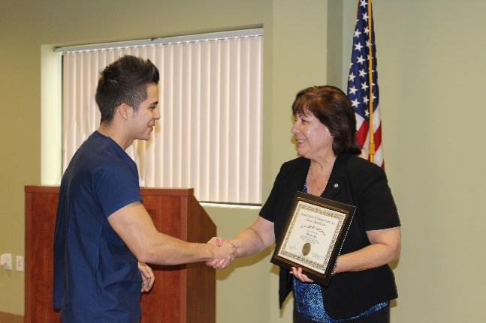
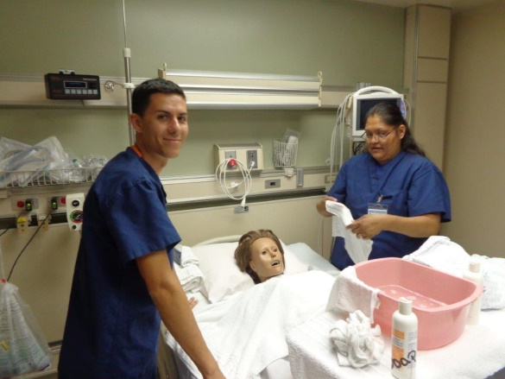
“Growing Our Own”
Medical Assistant
Medical Office Specialist
Nursing Assistant
Medical Coder & Biller
Pharmacy Technician
Phlebotomy Technician
Medication Assistant
Caregiver
Nutrition & Food Services Management
ServSafe (National Certification)
CPR and First Aid

Slide 48
College of Health Careers Collaborators & Student’s Sponsors

Slide 49
Health Promotion and Disease Prevention Social Determinants of Health (SDoH)

Slide 50
“Improving Health Equity Through Collective Community Action”
June 2018

Slide 51
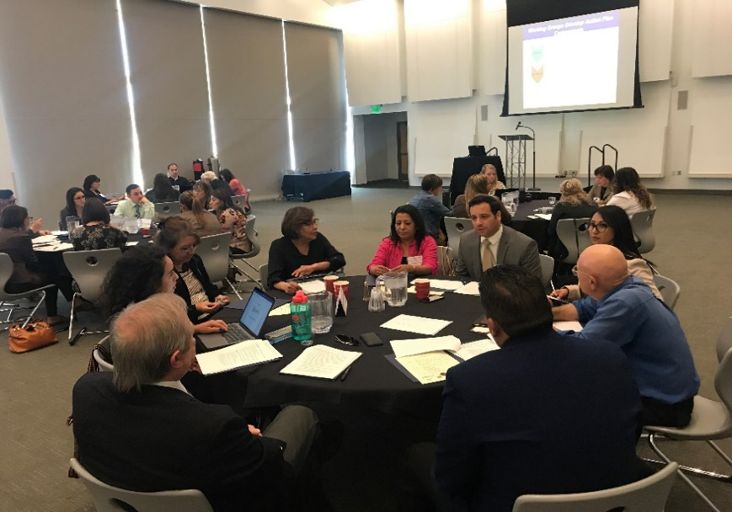
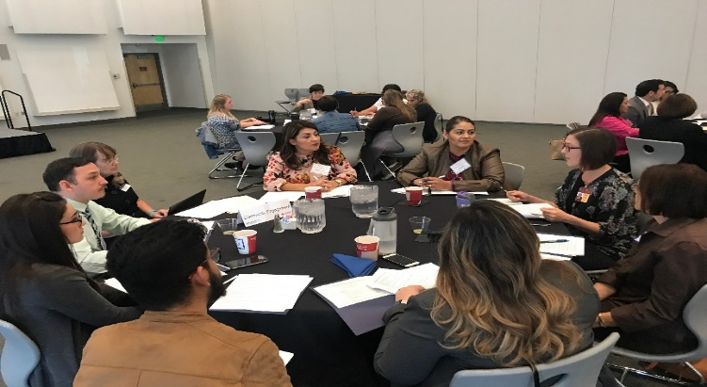
2nd Annual ABRC Yuma County Forum
“Improving Health Equity Through Collective Community Action”
Recommendations for Community Action
Binational Border Health Working Group
-Improve access to health care
-Provide health education options
Community Engagement Working Group
-Share Data
-Policy Development Collaborative
Clinical Research Based Agenda Working Group
-Support development of regional research council
-Workforce development/capacity building
Workforce Development Working Group
-Create a higher education pathway-trade and vocational skills
-Create opportunities for economic, professional, individual growth

Slide 52
Q & A
Thank you!
Amanda Aguirre
President & CEO
amanda@rcfbh.org
Joena Ezroj
WAHEC Director
jezroj@rcbh.edu
www.rcfbh.org

Slide 53
Looking Toward the Future:
The State and Regional AHEC Priorities in a Post-Pandemic Arizona
Kim Russell, Representative on Behalf of the new Tribal AHEC

Slide 54
Morning Breakout Sessions: Attend 2 of 3 Sessions
Session #1: 10:45 – 11:30 am
Session #2: 11:35 – 12:20 pm
Post Pandemic Vaccination Coverage: Workforce Intervention Strategies to Catch Kids Up
Satya Sarma, AHCCCS
Vijette, Saari, First Things First
Jennifer Tinney, TAPI
Clinical Rotations & Enhancing Training Center Locations
Wendy Redford, Wesley Community & Health Centers
Leveraging Telehealth in Medicaid During COVID: Look to the Future
Sara Salek, AHCCCS
Justin Bayless, Bayless Integrated Healthcare

Slide 55
Lunch Break: 12:20 - 1:00pm
Please Return to Ballroom at 1:00pm
Thank You to Our Sponsors!

Slide 56
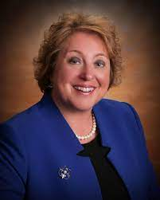
The American Rescue Plan Act:
Unprecedented Opportunities to Invest in Public Health
Suzanne Pfister, President & CEO, Vitalyst Health Foundation

Slide 57
The American Rescue Plan Act How To Influence This “Once in a Generation” Funding Opportunity

Slide 58
Who is Vitalyst Health Foundation?
Mission: To connect, support, and inform efforts that improve the health of individuals and communities in Arizona
All individuals and communities in Arizona are healthy and resilient

Slide 59
Vitalyst Goals
Improve
Improve access to care and coverage
Advance
Advance community policies that result in healthy communities that are accessible to all
Increase
Increase the capacity of community-based leaders, organizations and coalitions
Cultivate
Cultivate collaborations that leverage the elements of a healthy community
Increase
Increase civic participation for inclusive decision-making to advance health equity

Slide 60
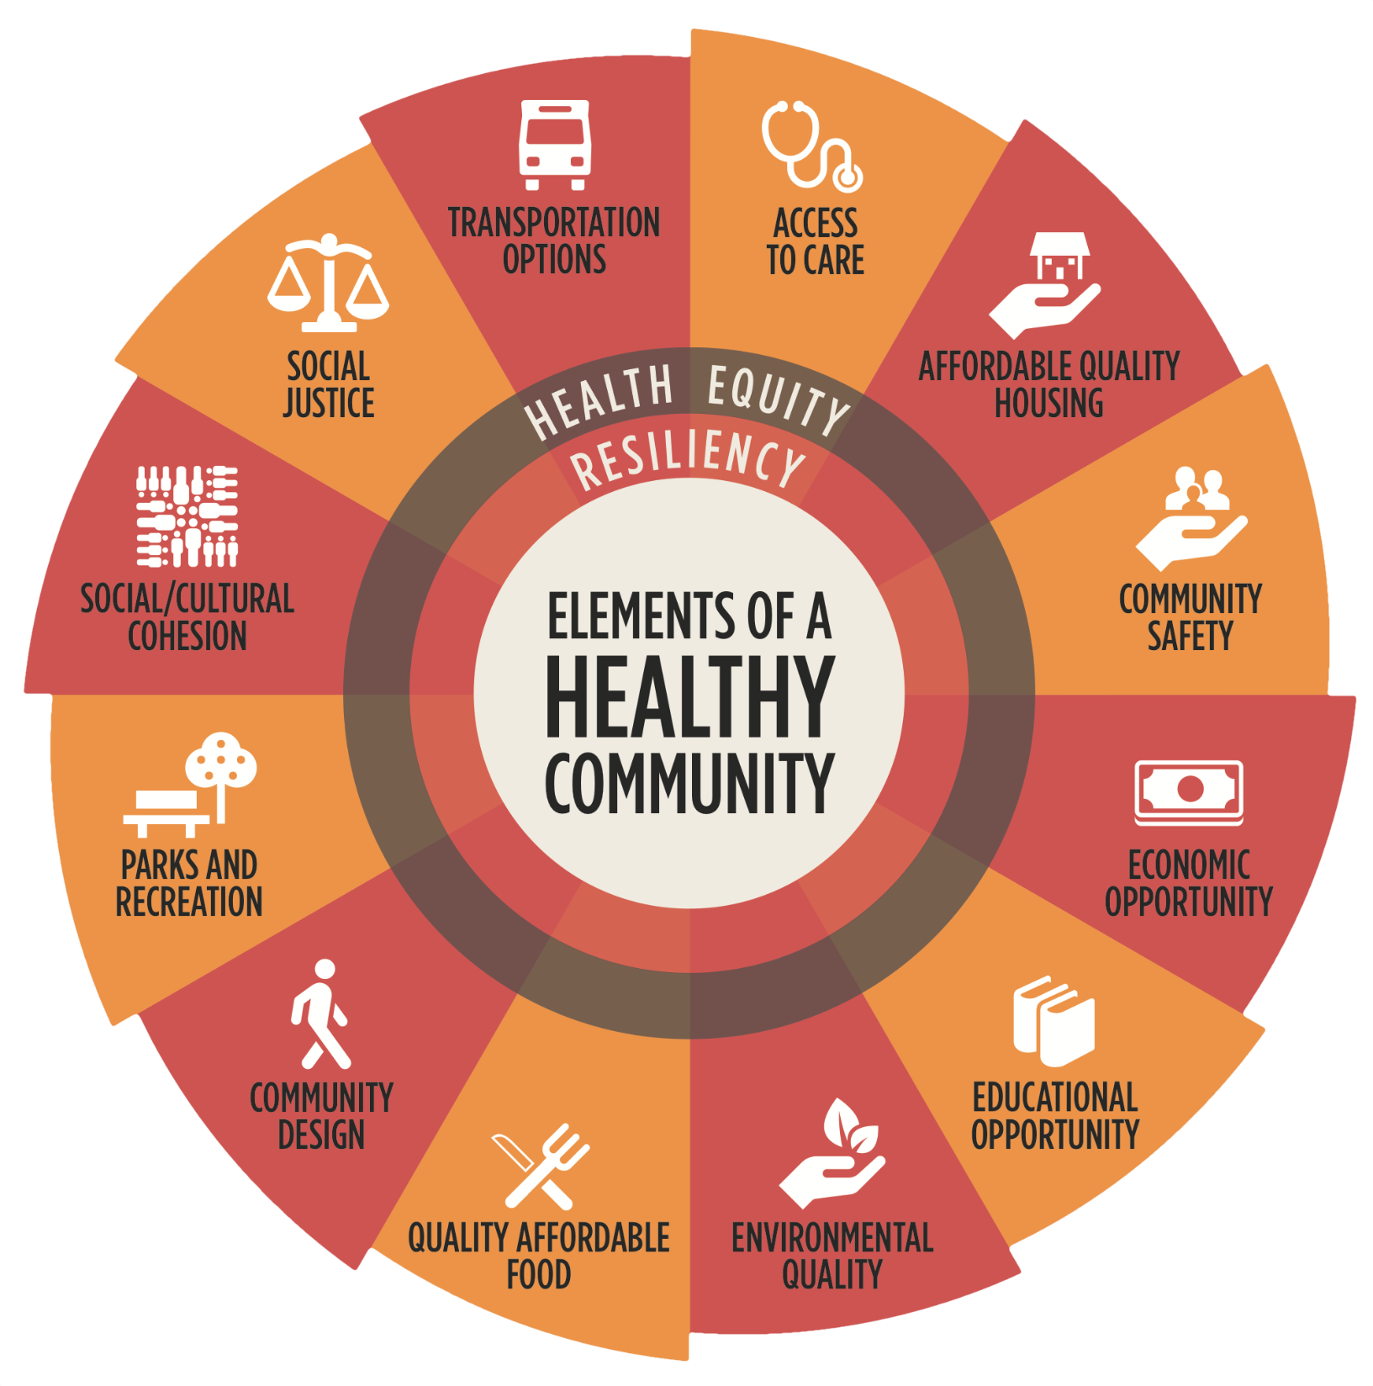

Slide 61
Today’s Presentation
Results of new research on the ARP Act Funds coming to Arizona
What Governments might do
What Vitalyst will do
What you can do

Slide 62
The American Rescue Plan Act
The ARP funds are designed to address the following areas:
Support urgent COVID-19 response efforts to continue to decrease the spread of the virus and bring the pandemic under control;
Replace lost public sector revenue to strengthen support for vital public services and to help retain jobs;
Support immediate economic stabilization for households and businesses; and
Address systemic public health and economic challenges that have contributed to the inequal impact of the pandemic on certain populations.

Slide 63
The American Rescue Plan (ARP) and Arizona
$24.5 billion coming to Arizona:
$12.2 billion to the state
$2.6 billion to local levels
1.2 billion in business aid
$8.5 billion in direct stimulus payments

Slide 64
Vitalyst Research
Consultant team interviewed/surveyed state agency leaders, counties, and 20 largest cities
How they were going to spend the ARPA money
What kinds of disparities they would address
Would the public be consulted
Sharing best practices
How would they analyze the impacts

Slide 65
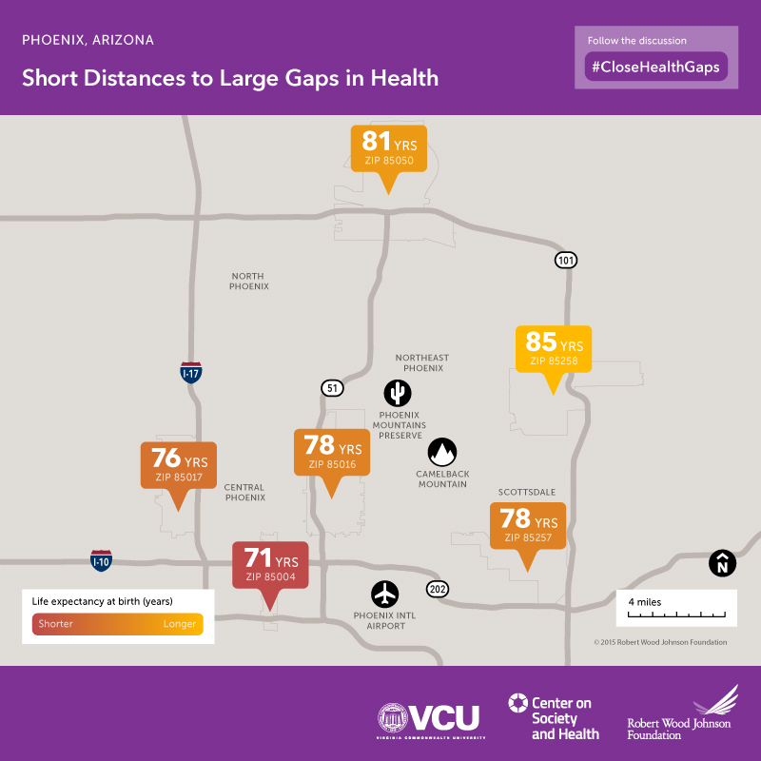

Slide 66
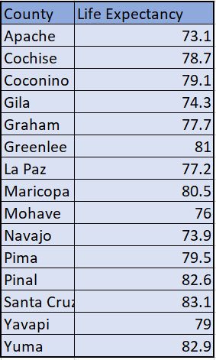
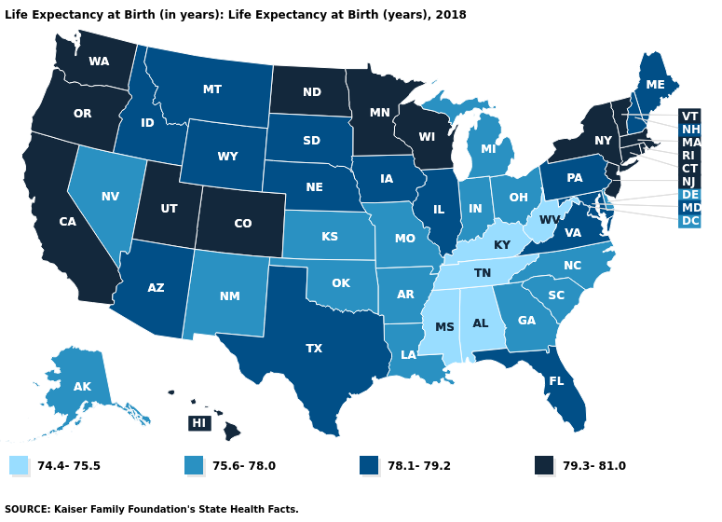
The average life expectancy in the US and Arizona is 78.7 years.
Six of the state’s counties fall below the nation average life expectancy of 78.7 years.
Data Source: National Center for Health Statistics. 2021
Notes:
County Data Source-
The 2021 County Health Rankings used data from 2017-2019 for this measure, provided by the National Center for Health Statistics - Mortality Files –
https://www.countyhealthrankings.org/app/arizona/2021/measure/outcomes/147/data
Arizona State Data Sources
Arias E, Bastian B, Xu JQ, Tejada-Vera B. U.S. state life tables, 2018. National Vital Statistics Reports; vol 70 no 1. National Center for Health Statistics. 2021
https://www.cdc.gov/nchs/data/vsrr/VSRR10-508.pdf
Additionally, we know in AZ the life expectancy for American Indians falls 10 years lower than the state average.
Robert Wood Johnson Foundation “Short Distances to Large Gaps in Health”
https://www.rwjf.org/en/library/interactives/whereyouliveaffectshowlongyoulive.html

Slide 67
Social vulnerability index (SVI) ranks communities by social factors and estimates readiness or vulnerability in the event of an emergency. The closer to 1 indicates the highest risk.
Socioeconomic Status | Below Poverty Unemployed Income No High School Diploma
Household Composition & Disability | Aged 65 or Older Aged 17 or Younger Civilian with a Disability Single-Parent Households
Minority Status & Language | Minority Speak English “Less than Well”
Housing & Transportation | Multi-Unit Structures Mobile Homes Crowding No Vehicle Group Quarters
< .65 |  | .70 - .80 |  | > .90
ATSDR Social Vulnerability Index, 2016
Notes:
*ATSDR Social Vulnerability Index https://svi.cdc.gov/Documents/Data/2014_SVI_Data/SVI2014Documentation.pdf
https://svi.cdc.gov/SVIDataToolsDownload.html
Score 0 – 1 with 1 = most vulnerable and 0 = least
For 2016, Navajo County had the highest SVI at .995 followed by Yuma County at .99.

Slide 68
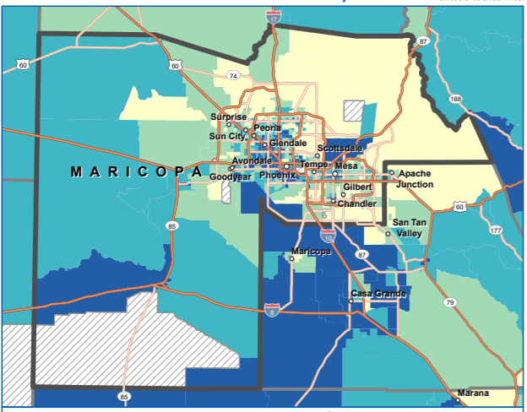
CDC Social Vulnerability Index 2018
Maricopa County
Notes:
https://svi.cdc.gov/Documents/CountyMaps/2018/Arizona/Arizona2018_Maricopa.pdf

Slide 69
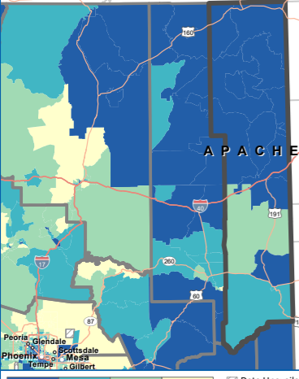
CDC Social Vulnerability Index 2018
Apache County
Notes:
https://svi.cdc.gov/Documents/CountyMaps/2018/Arizona/Arizona2018_Apache.pdf

Slide 70
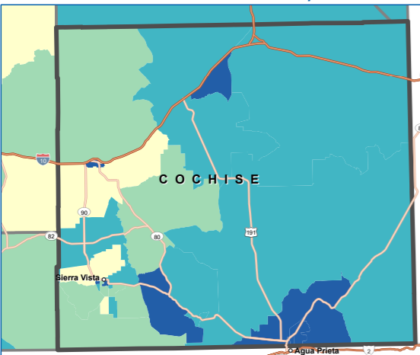
CDC Social Vulnerability Index 2018
Cochise County
Notes:
CDC Social Vulnerability Index 2018
Cochise County
https://svi.cdc.gov/Documents/CountyMaps/2018/Arizona/Arizona2018_Cochise.pdf

Slide 71
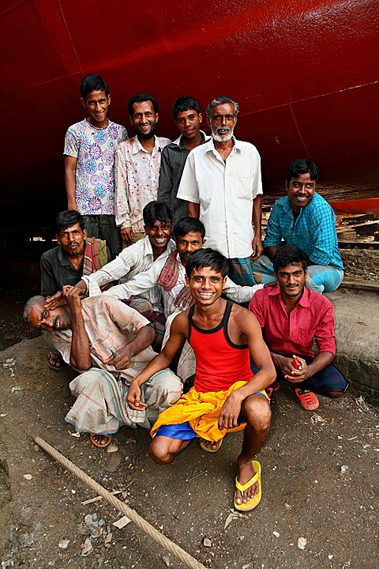
Health Disparities Are Real
This Photo by Unknown Author is licensed under CC BY-NC

Slide 72
What Our Research Found
Large infusion of fund presents challenges
Lack infrastructure and workforce
Departments are siloed
Data sharing is difficult
Moving money too fast through existing systems can continue disparities
It’s hard to prepare good milestones evaluation

Slide 73
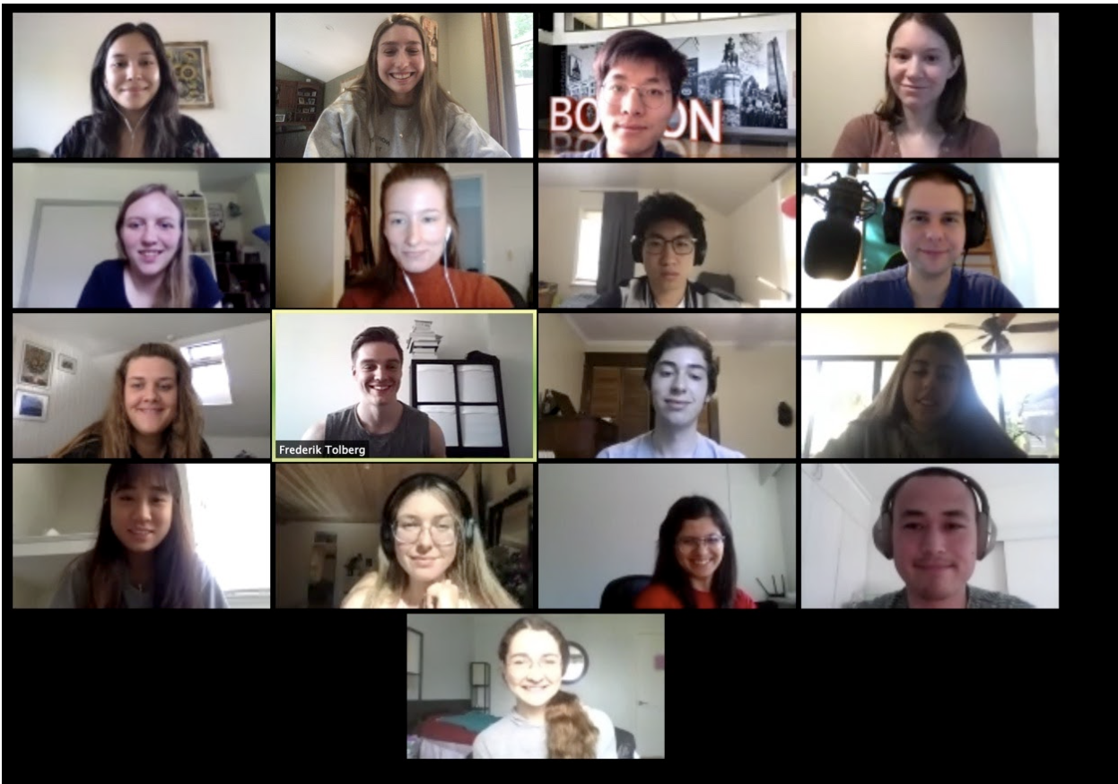
AZ Town Hall Feedback
East Valley, West Valley, Northern and Southern AZ, Statewide
Several hundreds residents
Asked “This is one-time funding – how should it be spent?”
This Photo by Unknown Author is licensed under CC BY

Slide 74
AZ Town Hall Feedback
Affordable Housing/Evictions
Healthcare
Environmental pollution
Infrastructure
Business assistance
Communications to the public
Mental Health & Substance Abuse
Childcare
Broadband

Slide 75
AZ Town Hall Feedback
Affordable Housing/Evictions
Healthcare
Environmental pollution
Infrastructure
Business assistance
Communications to the public
Mental Health & Substance Abuse
Childcare
Broadband

Slide 76
What Needs To Happen
Incorporate strategic planning principles
Short-term plans and longer-term considerations
Disaggregate the data to know where to target the funds
Build on best practices
Utilize existing partnerships and community groups
Develop milestones that can be measured and tracked

Slide 77
What Government Should Do
Utilize
Utilize existing commissions, coalitions and community agencies
Create
Create an interdepartmental team – break down the silos!
Look
Look for ways to utilize existing data sources and/or data sharing agreements
Get
Get disparity data to finance officers and other department heads

Slide 78
What Government Should Do
Use best practices – procurement samples
Leverage ARPA funds for public health workforce development
Strong communications and community outreach is needed

Slide 79
What Vitalyst is Going To Do
Use the Vitalyst Data Dashboard to make it easy to look at disaggregated data
State Health Assessment
MAG data sources
University sources

Slide 80
Sample of what we provided
Notes:
Take a screen shot of a county

Slide 81
Description of Population Facing Greatest Disparities or Most Impacted by COVID19
South Phoenix Metro Region: Vitalyst is focusing on this area including Central City, Maryvale, and the West Valley.
This is because the zip codes show on the map below were either in the top 10th percentile of COVID Prevalence, Unemployment Insurance Claim Prevalence, or both.

Slide 82
What Vitalyst is Going To Do
Use the Vitalyst Data Dashboard to make it easy to look at disaggregated data
State Health Assessment
MAG data sources
Share best practices through webinars, podcasts and reports
Stress equitable practices

Slide 83
Priorities for Advancing Racial Equity
Acknowledge the need for equity
Engage underserved communities
Connect unemployed and low-wage with good jobs and pathways
Stabilize businesses owned by people of color
Restore public services and infrastructure
Source: PolicyLink

Slide 84
Priorities for Advancing Racial Equity
Invest in COVID-19 impacted and disinvested communities
Prevent home displacement
Strengthen civic infrastructure
Make cross-sector investments
Track disaggregated data

Slide 85
What Vitalyst is Going To Do
Support communications efforts to report on successes/shifts so policymakers understand the impacts to the public.
Surface barriers (like data sharing)
Facilitate coalitions working on these systemic problems

Slide 86
All of This is Public Health
Cultivate collaborations and innovations that leverage the elements of a healthy community

Slide 87
Your Mission:
Many plans are due in late August – Watch for them and comment!
Create/join an interdepartmental group – talk about how the ARP funds can be “braided” with existing or new funds
Make sure you are using the commissions/committees you already have
Work with your communications teams to strengthen the messaging
Prioritize equity and
use data

Slide 88
For More Information
Vitalysthealth.org

Slide 89
For More Information
Vitalysthealth.org

Slide 90
Afternoon Breakout Sessions: Attend 2 of 3 Sessions
Session #1: 2:15 – 3:00 pm
Session #2: 3:05 – 3:50 pm
CHRs and CHWs COVID Response: Leveraging CHWs & CHRs in a Post-pandemic Arizona
Flor Redondo, Arizona Community Health Worker Workforce Coalition
Maia Ingram, Arizona Prevention Research Center
Mae-Gilene Begay, Navajo Nation
Maria Valenzuela, Esperanca
Update on Arizona’s Loan Repayment Programs
Edith DiSanto, ADHS
Will Humble, AzPHA
Post COVID County Public Health
Leslie Horton, Yavapai County Community Health Services, ALHOA President
Marcy Flanagan, Maricopa County Department of Public Health

Slide 91
Building Under-Represented Populations into the Healthcare Workforce
Francisco Lucio, JD Associate Dean, Equity, Diversity and Inclusion, UArizona College of Medicine, Phoenix

Slide 92
Closing Remarks Kim Van Pelt, AzPHA President Elect
Title Sponsor

Slide 93
UPCOMING EVENTS
AZPHA ANNUAL AWARDS PROGRAM
Tuesday November 9, 2021
5:00 pm to 8:30 pm
University Club 39 E Monte Vista Road Phoenix, AZ 85004
AZPHA ANNUAL MEMBER MEETING
Wednesday November 10, 2021
12:00 noon to 1:30 pm
Zoom Information provided upon registration

Slide 94
Thank You to Our Sponsors!
Title Sponsor

