Slide 1
AzPHA Treasurer’s Report
FY2023 (July 1, 2022 – June 30, 2023)
Annual Members Meeting November 30, 2023

Slide 2
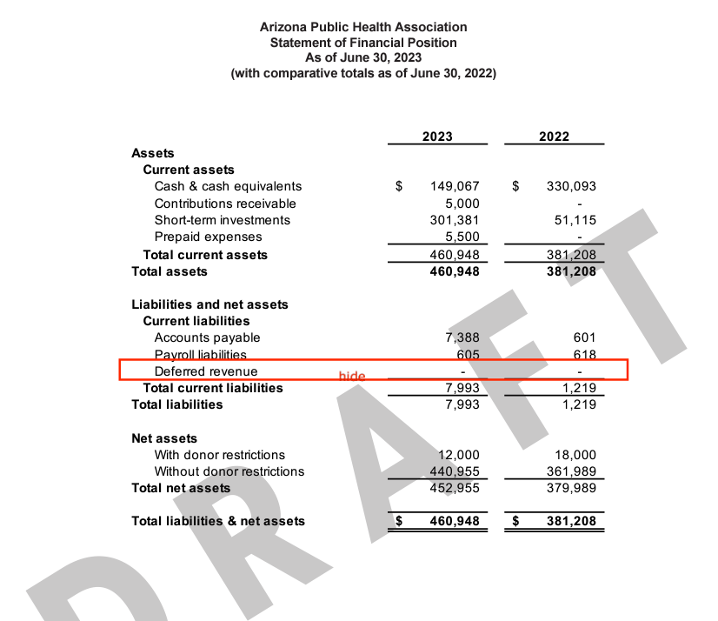
AzPHA Balance Sheet (FY2023- June 30, 2023)

Slide 3
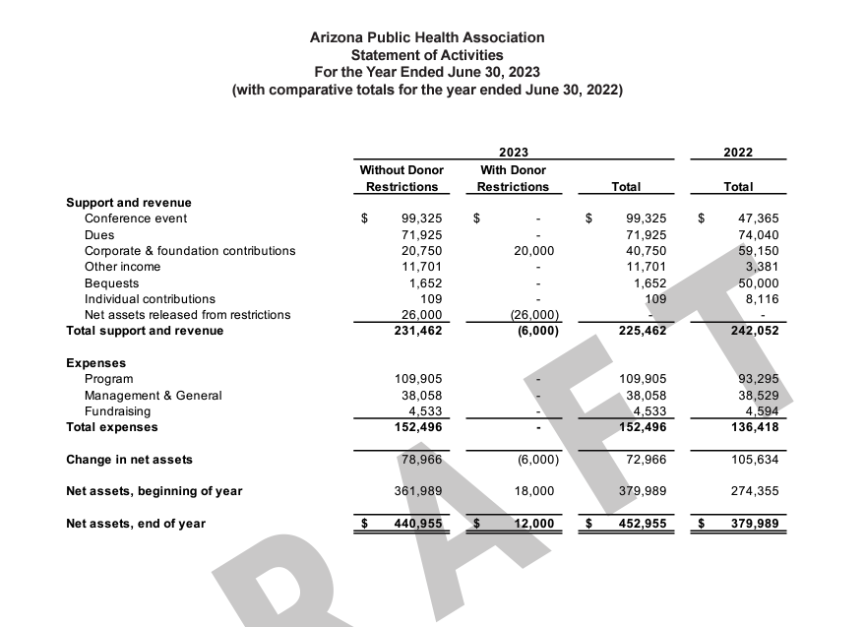
Year-end Net Assets (June 30, 2023)

Slide 4
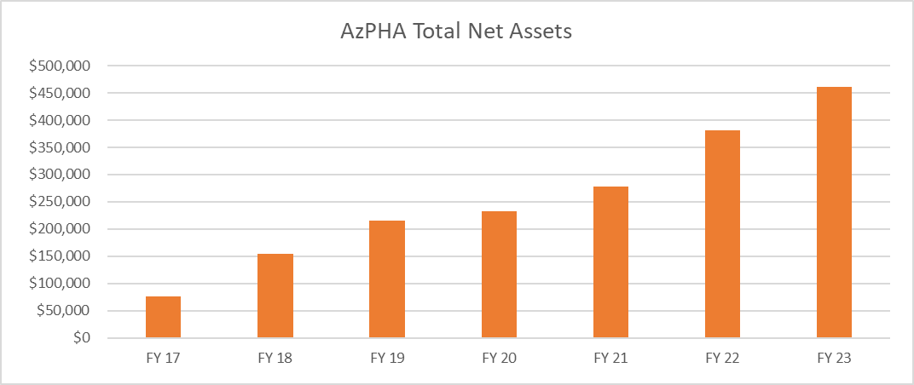
AzPHA Net Asset Trends (FY17-23)

Slide 5
Additional Financial Reports
AzPHA FY23 Financial Compilation Report(DRAFT-FINAL)
AZPHA FY23 IRS 990 Final

